Slide 1

Discrete Mathematics
Centurion University Of Technology and Management, Bhubaneswar

Slide 2
Content
Proposition
Types of Proposition
Conjuction
Disjunction
Exclusive
Conditional
Biconditional
Negation
Equivalence of Statement
Converse
Inverse
Contrapositive
Tautology
Contradiction
Contingency
Predicates and Quantifiers
Universal Quantifiers
Existencial Quantifiers
Theory of Inference
Types of inference
Argument
Validity of Argument
De-Morgans Law

Slide 3
Proposition
A declarative sentence which is either ‘True” or “False” not in both.
EX:-The sum of two even number is always even.
Types of proposition:
(a) Simple proposition
(b) Compound proposition

Slide 4
(a)Simple Proposition
Proposition having only one declarative sentence is called simple proposition.
EX:-P is either T/F
Jupiter is a star(F)
Ram is a boy(T)

Slide 5
(b)Compound Proposition
A compound proposition can be formed by combining two or more simple proposition by means of connecting.
EX:-if P is “False” and Q is “False”
Then P ∨ Q is “False”.

Slide 6
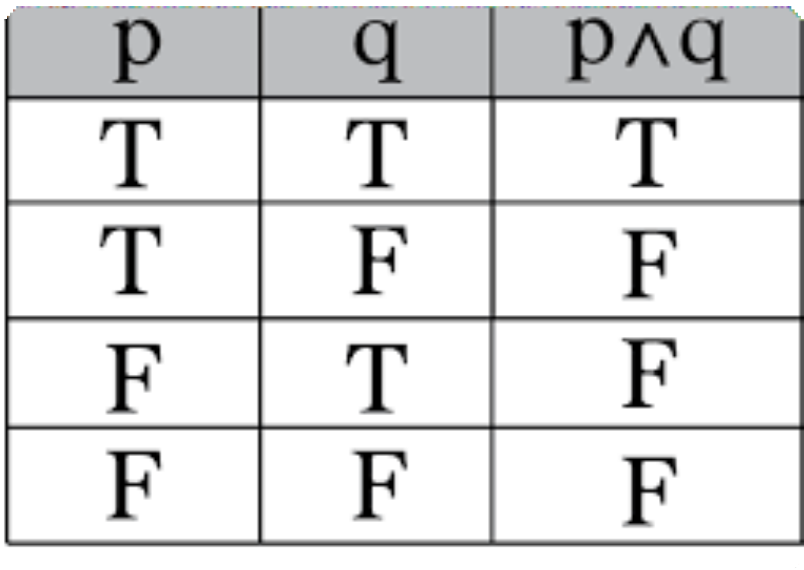
Conjunction
The conjunction of two simple proposition is denoted by “P ∧ Q”.
The compound proposition is true when both P and Q are “True”
Example:
P:Ram is a boy
Q:Ram goes to school everyday.
P ∧ Q:Ram is a boy and he goes to school everyday.

Slide 7
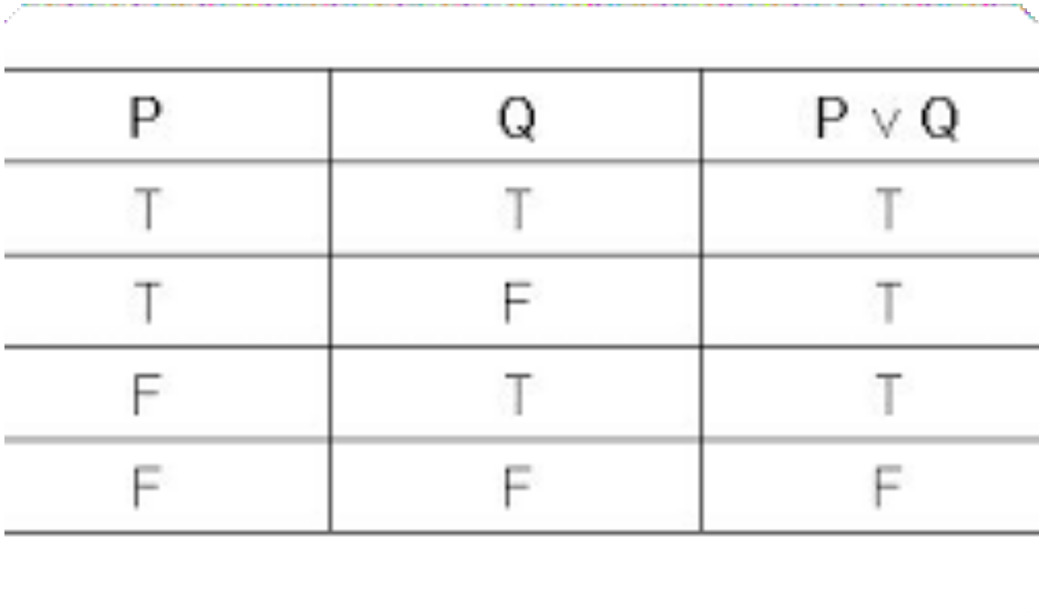
Disjunction
The Disjunction of two simple preposition is denoted by “P V Q”.
A compound proposition is False when both P and Q are False , otherwise True.
Example:
P:Hari is reading
Q:Hari is sleeping
P V Q:Hari is reading or he is sleeping.

Slide 8
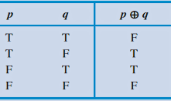
Exclusive or (xor)
It is denoted by P⊕ Q.
The proposition which is True if exactly one of P and Q is True otherwise False.

Slide 9
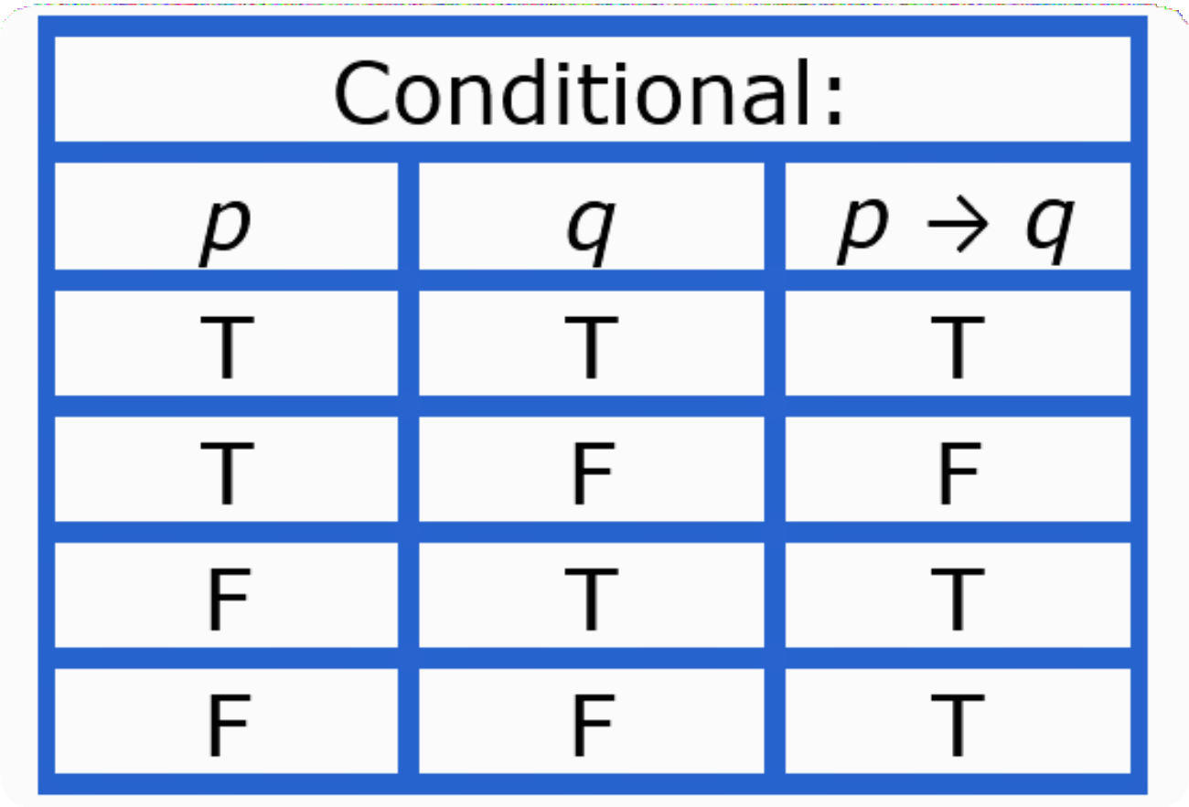
Conditional
It is denoted by , p→q.
If P statement is True and Q statement is False then the output is false otherwise True.
Example:
P: You work hard.
Q: You will pass in the examination.
P→Q : If you work hard then you will pass in the examination.

Slide 10
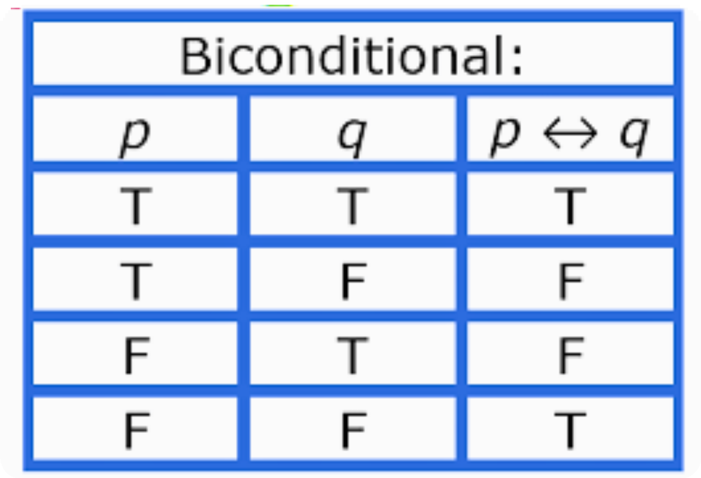
Biconditional
It is denoted by , p⇔q .
The biconditional satement takes the value true if both the statement having same truth value, otherwise False.
Example:

Slide 11
Negation
In mathmatics , the negation of a statement is the opposite of the given mathmatical statement.
If P is an statement then negation of statement P is represented as “¬P”.
It is observed that the negation of the negated sentence is the original statement.
Example:
If P is True
Then negation(¬P) is False.

Slide 12
Equivalence of Statement
Two compound proposition are said to be equivalence if they have the same truth value for any kind of assignment to its prime component.
If P and Q having the same truth value then we can write “P≡Q”.
Two statement are equivalent if they always have the same logical value which is either “True” Or “False”.
EX:”X=3” and “X+2=5" are equivalent because if one is True the other is also True.

Slide 13
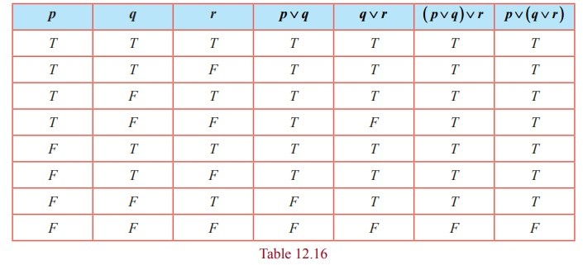
To show that (p V q) r and p V (q V r) are logical equivalence

Slide 14
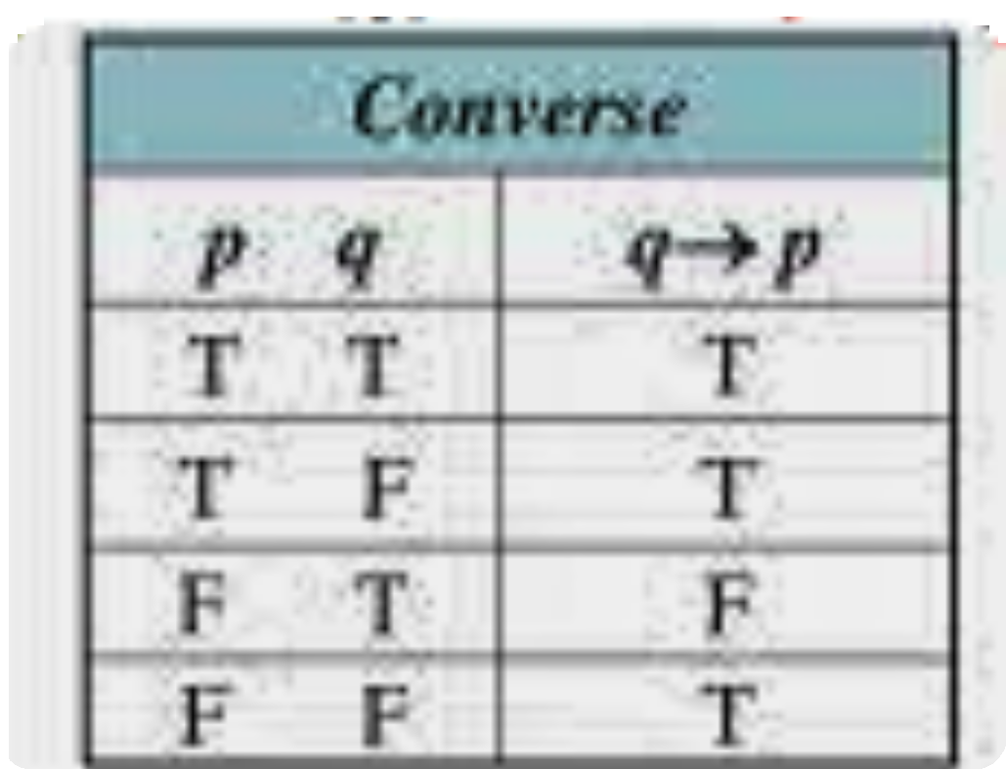
Converse
If P→Q is a conditional then Converse of this statement is defined as Q→P.
Example
If P→Q is False
Then Q→P is True.

Slide 15
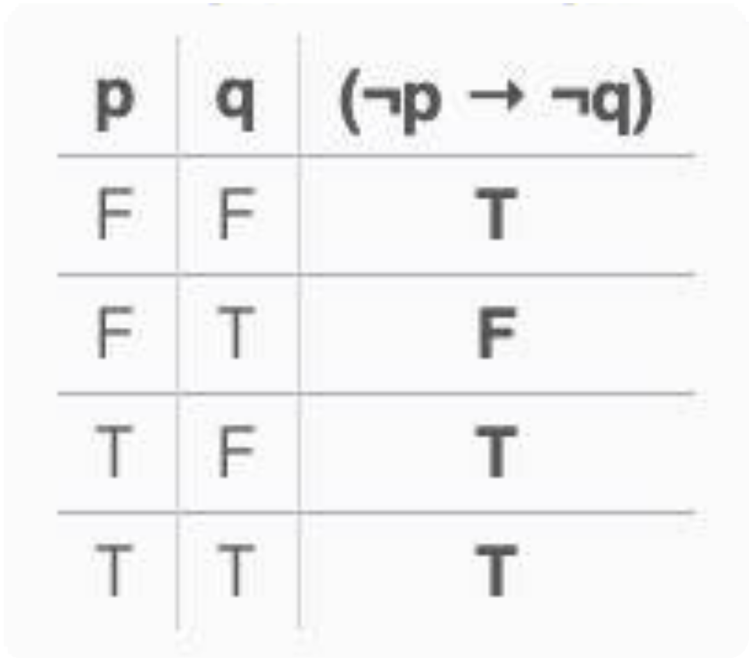
Inverse
If P→Q is a conditional then Inverse of this statement is defined as ¬P→¬Q .
Example:
If P→Q is True
Then is ¬P→¬Q False

Slide 16
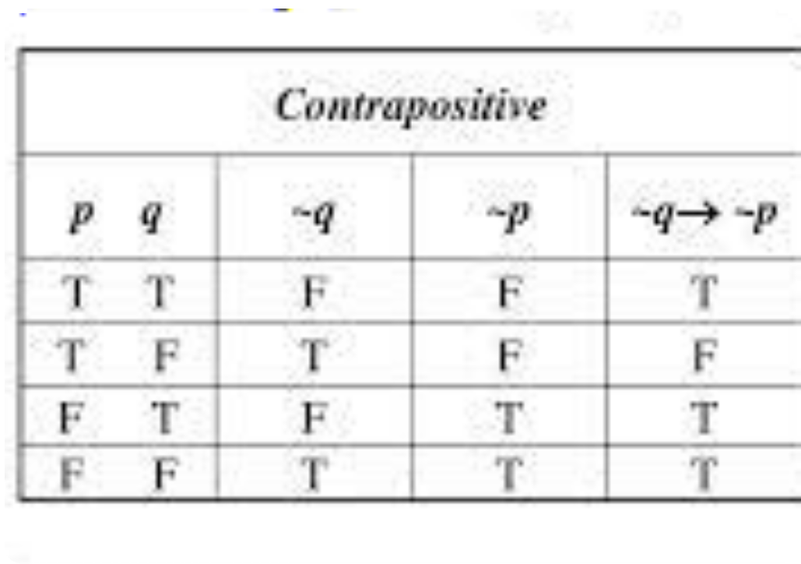
Contrapositive
If P→Q is a conditional the Contrapositive of this statement is defined as ¬Q →¬P.
Example:
If P→Q is True
Then is False.

Slide 17
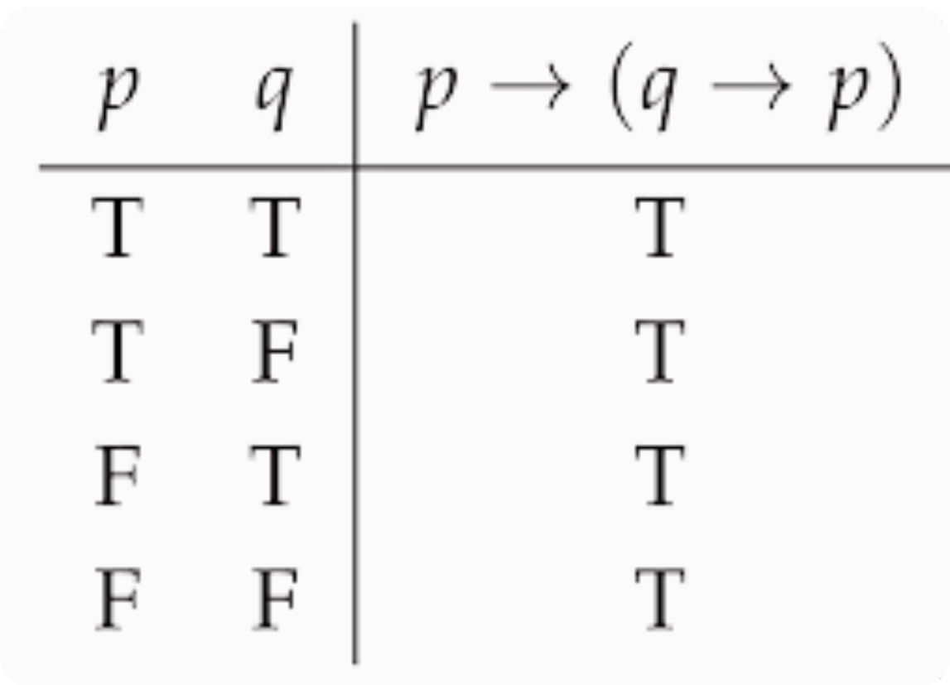
Tautology
A compound proposition which is always “True” for its prime components is called Tautology.

Slide 18
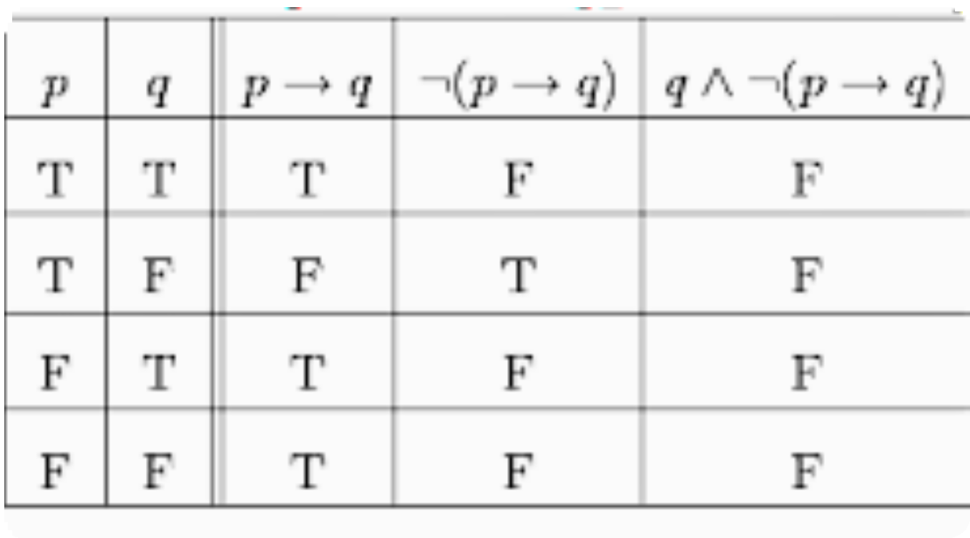
Contradiction
A compound proposition which is always “False” for its prime components is called Contradiction.

Slide 19
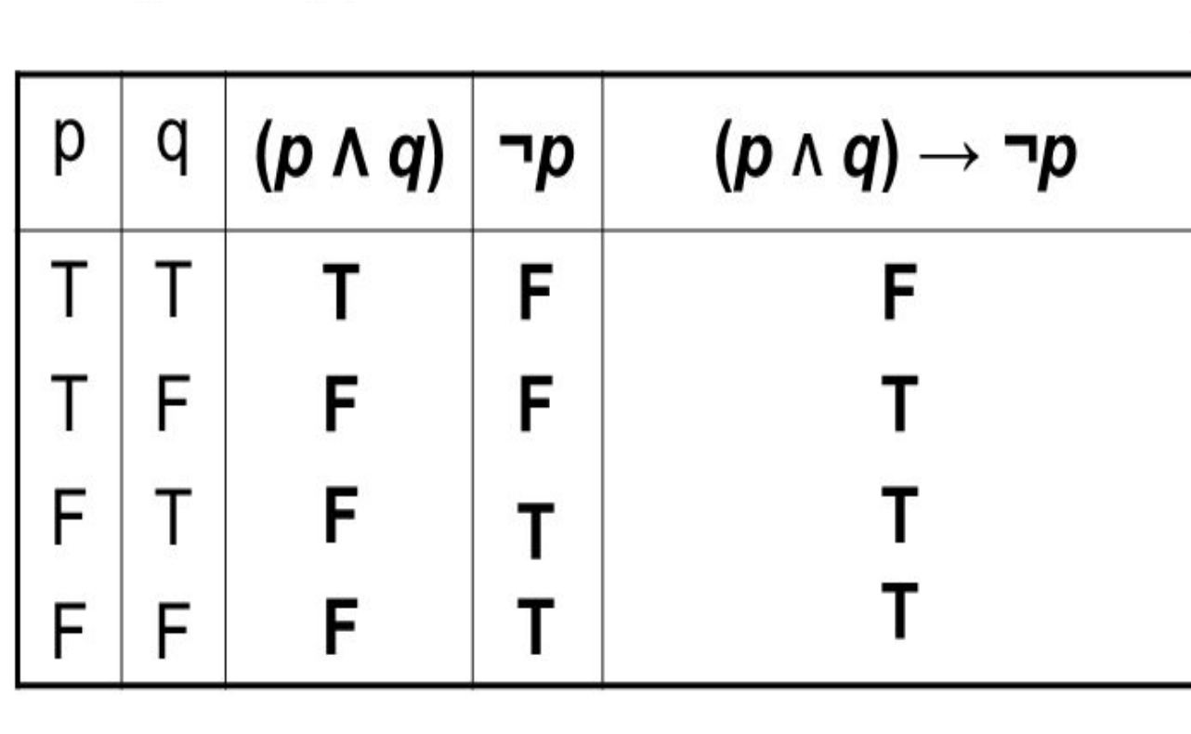
Contingency
A compound proposition which is both “true”and “False” for its prime components is called Contingency.

Slide 20
Predicates and Quantifiers
Predicates:
In math, a predicate is the part of a sentence that describes the action of the subject, or what the subject is doing.
Predicates are also called propositional functions and are often written like functions, such as p(x), f(x), or ψ(x).
Example:
X is less than 9
where ‘X’ is subject
and is less than 9 is Predicate.

Slide 21
Quantifiers:
In maths, quantifiers are words or expressions that indicate how many elements 0r quantity in a set satisfy a given predicate.
There are two main types of quantifiers:
1-Universal Quantifiers.
2-Existencial Quantifiers

Slide 22
Universal Quantifiers
A universal quantifier is a logical constant that expresses a predicate is True for every member of a domain.
The universal quantifier denoted by the symbol ‘∀’ or “For all”.
(∀ x ) ( 2 x is even ) , which can be translated as "for all natural numbers x, 2x is even."

Slide 23
Existencial Quantifiers
An existencial quantifier is a logical constant that expresses a predicate is True "for some" members of Domain.
It is represented by the symbol ∃.
( ∃ x ) ( 2 x is 10 ) , which can be translated as "there exists a natural number such that 2x = 10."

Slide 24
Theory of Inference
Premises:
It is proposition on the basis of which we would be able to draw a conclusion.
Or you can think of a premises as an evidence or assumption.
Therefore , initially we assume something is true and on the basis of that assumption ,we draw some conclusion.

Slide 25
Conclusion:
Conclusion is a proposition that is reached from the given set of premises.
You can think of it as result of assumptions that we made in an argument.
If premises is true then conclusion must be true.

Slide 26
Example:
All humans are mortal. [Major Premise]
Johnsina is a human. [Minor Premise]
Therefore, Johnsina is mortal. [Conclusion]
Example:
Nonrenewable resources do not exist in infinite supply. [Premise 1]
Coal is a nonrenewable resource. [Premise 2]
Coal does not exist in infinite supply. [Conclusion]

Slide 27
Conditions :-
Modus ponens:-
p(T)
p→q
q
Modus tollens:-
¬q(T )
p→q
¬p
Hypothetical syllogism:-
p→q(T)
q→r(T)
p→r(T)

Slide 28
Disjunctive Syllogism:-
p ∨ q
¬P
q
Addition:-
P(T)
p ∨ q(T)
Simplification:-
p ∧ q (T)
P
Conjuction: -
p (T)
q (T)
p ∧ q(T)
Resolution:-
p ∨ q(T)
¬P ∨ r(T)
q ∨ r (T)

Slide 29
Argument
sequence of statement that ends with a conclusion.
or
it is a set of one or more premises and a conclusion.

Slide 30
Validity of Argument
The validity of argument means if premises is True then conclusion must be True.
Example: ”If i love cat then i love dog.”
“i love cat.”
Therefore,”i love dog.”

Slide 31
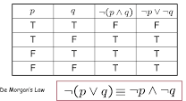
De-Morgan’s Law
1- ¬(P ∧ Q)= ¬P ∨ ¬Q
2- ¬(P ∨ Q)= ¬P ∧ ¬Q

Slide 32

¬(P ∧ Q)= ¬P ∨ ¬Q

Slide 33


